Slide 1

Zoom Meeting with
Stakeholders
The contents of this presentation were developed under a grant from the National Institute on Disability, Independent Living, and Rehabilitation Research (NIDILRR grant number 90IFDV0028). NIDILRR is a Center within the Administration for Community Living (ACL), Department of Health and Human Services (HHS). The contents of this presentation do not necessarily represent the policy of NIDILRR, ACL, or HHS, and you should not assume endorsement by the Federal Government.
October 23, 2025

Slide 2
VR-ROI Project Team
George Washington University – Maureen McGuire-Kuletz, Joe Ashley, Crystal Garry, and John Walsh
University of Richmond (Emeritus) – Bob Schmidt
University of Virginia – John Pepper
Stony Brook University – Steven Stern
University of Chicago – Chris Clapp
University of Montana Rural Institute – Catherine Ipsen

Slide 3
Objectives for Today
Solicit feedback on the structural and simplified ROI models, including trade-offs between model detail and ease of implementation.
Gain insights on integrating rapid engagement and service intensity into ROI models.
Refine the VR-ROI model to ensure it remains practical, actionable, and valuable for the VR community.

Slide 4
Agenda for Today
Overview of this Project: The VR-ROI Model – Bob Schmidt
Updated Data from North Carolina – Chris Clapp
Update on Rapid Engagement Measures – Steven Stern
Update on Intensity & Source of Service Measures – Steven Stern
Update on Model Simplification – John Pepper
Challenges in Estimating Service Impacts – Steven Stern
Wrap-up – All

Slide 5
Poll: Who is with us today? Select the option that best describes your current role
Advocacy Organization Representative
SRC members
Consumer or Family Member
Administrator – State VR Agency
VR Counselor or Field Staff – State VR Agency
Education Partner (e.g., Transition or Special Education)
Independent Living (IL) Representative
Community Rehabilitation Partner (CRP) Representative
Workforce Development Partner (e.g., American Job Center, WIOA partner)
Business Representative
Other (please specify in chat)
Notes:
Critical Piece of the Puzzle: Make sure that tools, products, and approach are not created inside of a vacuum without appropriate feedback. Thus, are getting feedback from North Carolina Staff, Advisory Council, and Stakeholders.

Slide 6
Some Background About the VR – ROI Approach (1 of 3)
3rd of 3 NIDILRR grants; disclaimer
Conducts longitudinal analyses with up to 3 years of pre-VR employment data and at least 4 years of post-application data
Employs state-of-the-science statistical controls to ensure that the outcomes are the result of VR rather than other factors

Slide 7
Some Background About the VR – ROI Approach (2 of 3)
Uses readily-available administrative data for an application cohort:
  Characteristics of VR program participants
  9-11 VR service categories from 26 RSA categories
    Each state does differently
    From 3 sources: purchased, agency, comparable benefits
    Intensity measured by expenditure and length of service
  Rapid engagement
  Employment and earnings from state UI program records

Slide 8
Some Background: Outcomes
(3 of 3)
Estimates the impact of specific types of VR services on participants’ employment and earnings
  Made separately by disabling condition
  Made at the individual level
Estimates quarterly and annual rates of return (ROR) for specific disabling conditions as well as agency-wide

Slide 9
Updated Data from NC
(1 of 2)
Table 1: Sample Size by Group and Year
Disability | 2018 or 2019
MI (Mental Illness) | 12,414
PI (Physical Impairment) | 8,562
CI (Cognitive Impairment) | 8,910
BVI (Blind & Visual Impairment) | 1,032
ASD (Autism Spectrum Disorder) | 2,318
ADHD | 2,933
TBI (Traumatic Brain Injury) | 525
Substance Abuse | 3,978
Overall | 36,467
Notes:
This table shows samples sizes for VR applicants in State Fiscal Years 2018 or 2019. There is a separate row for 8 broad disabling conditions as well as overall (36,467). Sample sizes are large enough to estimate a complicated model and obtain precise estimates. The sole exception is for Traumatic Brain Injury with only 525 individuals. Others range from 1,032 for Blind & Visual Impairment to 12,414 for Cognitive Impairment.

Slide 10
Updated Data from NC
(2 of 2)
Table 2: Percent of Applicants Receiving Purchased Services
by Disability and Service Type, 2018-2019
Service Type | MI | PI | CI | BVI
Education | 2.6 | 3.2 | 2.1 | 6.1
Job Training | 8.5 | 7.8 | 19.6 | 6.4
Job Search & Placement | 17.0 | 10.9 | 23.9 | 4.2
Supported Employment | 6.5 | 3.0 | 13.8 | 1.6
Other Supports | 2.3 | 18.2 | 18.7 | 19.3
Sample size | 12,414 | 8,562 | 8,910 | 1,032
Notes:
This table shows the percent of clients receiving selected service categories (education, job training, job search & placement, supported employment, and other supports) and 4 disabling conditions (MI, PI, CI, BVI). The table reveals that there is variation in receipt across disability & service category. For example, education is provided for 2 or 3 percent of MI, PI, and CI but 6 percent for BVI. Percentages for CI is higher than any other disability for training (20%), job search and employment (24%), and supported employment (14%). At 18.7%, it is second only to BVI (19.3%) for other supports.

Slide 11
Measures of Rapid Engagement (1 of 2)
All 2018 Applicants
Measures in Data: Days from Application to
  Plan: Mean = 81, Median = 68
  1st Service: Mean = 126, Median 84
Varies by Disability: Median days to 1st service
  66 for BVI
  140 for CI
  177 for ASD

Slide 12
Measures of Rapid Engagement
(2 of 2)
Modelling Rapid (and meaningful) Engagement
We will estimate how rapid engagement changes service mixes and/or the intensity of services.
  We need to model the relationship between rapid engagement and employment and earnings to ensure that the estimates can be interpreted as causal rather than simply correlational.
Which of these measures (App to Plan, App to 1st Service) should we use and why?
How does time from Application to Plan or 1st Service matter to you?
  Are there key time thresholds, and if so, why?

Slide 13
Measures of Service Intensity (1 of 2)
Relevant Available Data
Service types and sources
  Purchased Services from case management system
  In-House and Comparable Benefits from RSA-911 quarterly reports
Measures of Service Intensity
  Dollar value of purchased services is reliable
  Number of quarters for any service
  For purchased services, these two are not perfectly correlated

Slide 14
Measures of Service Intensity (2 of 2):
4,942 VR applicants with a Cognitive Impairment
Examining Service Provision
It is important to allow for different types of services.
  Frequency of services received in same quarter (all quarters)
    1 service received in the quarter: 9,295 quarters
    2 different services in the quarter: 5,285 quarters
    3 or more services in the quarter: 4,680 quarters
It is important to allow for different types of services from different sources: purchased, agency, comparable benefits.
  Two examples of combinations of services by type and source in the same case
    62 cases with job training provided by both purchase and agency as well as education by comparable benefits
    21 cases with placement from purchase and agency, job training from agency, and supported employment from purchase

Slide 15
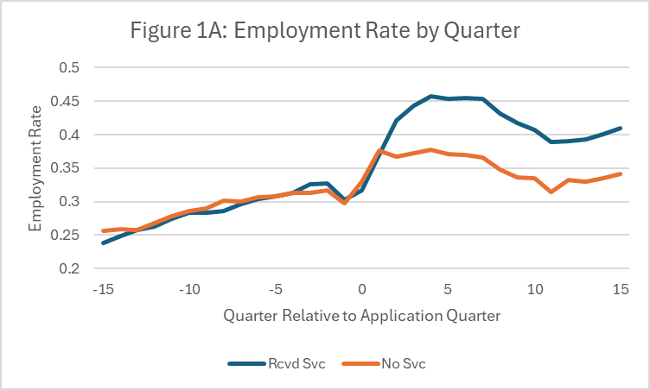
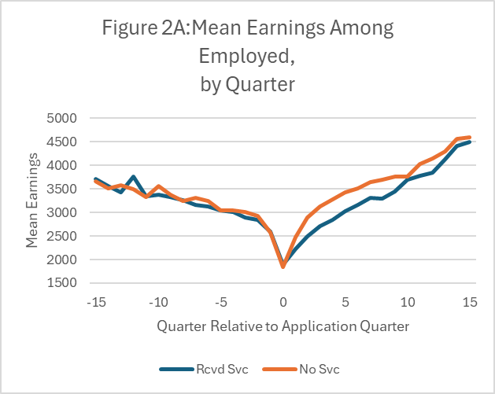
Simplified Model (1 of 4)
Notes:
There are 2 graphs on this slide. Figure 1A: Employment Rate by Quarter and Figure 2A: Mean Earnings Among Employed, by Quarter. Both include an alt tag description.

Slide 16
Simplified Model (2 of 4)
Table 4: Simple Model Regression (“DinD”), 2018 MI
Services | Employment Short Run | Employment Long Run | % Change in Earnings for the Employed Short Run | % Change in Earnings for Employed Long Run
Received Services | 0.073 | 0.067 | −0.123 | −0.037
Education | 0.043 | 0.104 | −0.196 | −0.018
Job Training | 0.047 | 0.128 | −0.184 | −0.058
Job Search & Placement | 0.085 | 0.080 | −0.116 | −0.009
Supported Employment | 0.077 | 0.090 | −0.090 | 0.037
Notes:
This table shows impacts on employment and earnings for anyone who received any service as well as for selected service categories (education, job training, job search and placement, supported employment, and other supports). The table presents impacts in the short run (SR: up to 8 quarters post-app) and long run (LR: over 8 quarters post-app). Employment impacts are all positive with the LR impact of job training being the highest. By contrast, all but one impact on employment for those who were employed being negative. The largest negative coefficient is for SR education which is likely because many remain in higher education for at least 8 quarters.
Although the magnitude of the employment impacts differ between the short and long runs, the SR and LR signs are the same for all service categories. This is also true for earnings impacts with one exception – the SR sign Is negative while the LR sign is positive.
The title notes that the impacts are estimated through the “DinD” regression statistical technique. “DinD” refers to the technique of estimating “Difference in Differences.” The first difference is the client-specific change in employment or earnings from the pre-application period to the SR or LR post-application period. The second difference represents the model’s estimate of the difference in those labor market changes between those receiving the service and those who did not.

Slide 17
Simplified Model (3 of 4)
Table 5: Mean Value of Purchased Services, 2018
Disability | Earnings
MI (Mental Illness) | 484
PI (Physical Impairment | −571
CI (Cognitive Impairment) | 250
BVI (Blind & Visual Impairment) | 551
ASD | 1,584
NOTE: These estimates have not accounted for costs. Net benefits will be lower after subtracting costs.
Notes:
This table show the mean value of purchased services separately for 5 disability categories: MI $484, PI (-571), CI (250), BVI (551), and ASD (1584) as well as for all 5 disabilities combined (-199).
The value of treatment for an individual is estimated by first combining the service’s impact on employment as well as its impact on earnings if employed separately for each service received. The individual service impacts are then totaled across all services received by the individual. Finally, the mean value is calculated by averaging across all individuals.

Slide 18
Simplified Model (4 of 4)
Structural Model:
How does it differ from the Simplified Model?
Controls for individual characteristics
Variability: Estimates vary by disability, service type, source of service, short & long run
Formal model of service receipt and labor market outcomes

Slide 19
Challenges in Estimating Service Impacts
Estimating different impacts for different service categories and sources
Aggregating Services, 12 currently:
Assessment
Disability & Treatment
Education
Job Training
Job Search and Placement
Supported Employment
Other supports
Benefits
Disability Accommodation
Adjustment to Disability
Rehabilitation Technology
Other Services

Slide 20
Wrap-up & Questions
Contact Information
Bob Schmidt rschmidt@richmond.edu
Chris Clapp cclapp@uchicago.edu
Steven Stern steven.stern@stonybrook.edu
John Pepper jvp3m@virginia.edu

